Slide 1
Geo-fencing of Rural Areas
Team Name :
BitsPlease
Team Members:
Kshitij Pawar
Vinay Nair
Meenal Chavan
Adwait Gore

Slide 2
Goals
Virtual Geo-fencing using GPS co-ordinates
Extracting satellite image of the land based on the co-ordinates.
Identifying the type of land(whether it is suitable for cultivation).
Identifying the cultivated crop in the geo-fence.
Using AI/ML to predict the future crops that could be cultivated.

Slide 3
Solution Flow
We are creating a web app which will allow an authorized person(admin) to register farmers.
The admin can then add the co-ordinates of the farmer’s land and on the basis of which geo-fencing of the farmer’s land will be done.
The satellite image of the farmer’s land will be also obtained using the co-ordinates of the geo-fence. And using image segmentation land utilization can also be determined.
The farmer will be allowed to upload the picture of the crop that is being cultivated in their land. By using Image Classification the crops cultivated at the geo-fence can be identified and added to records.
Future crops can be recommended based on the soil type identified from the crops cultivated in the geo-fence.

Slide 4
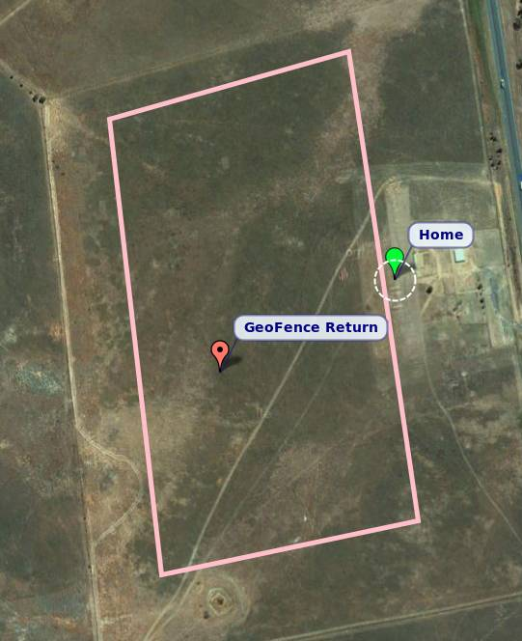
This is how geo-fencing will look. We are achieving that by HERE API and Google maps API.

